Slide 1
Tokenization
By: Kanchan keisham
ABR Lab

Slide 2
Introduction
Natural Language Processing (NLP) is a branch of Artificial Intelligence (AI) that provides machines (computers) the ability to understand written and spoken human language in the same way as human being.
A few examples are spell check, autocomplete, spam detection, Alexa, or Google assistant.
Pre-processing is the first step in working with text and in building a model to solve our business problem. Here we will discuss about tokenizers and tokenization.
Tokenization
Tokenization is one of the most important steps in text pre-processing. Whether you are working with traditional NLP techniques or using advanced deep-learning techniques, you cannot skip this step.
Notes:
Ocr – 광학 문자 인식
Ridge – 융선(지문)

Slide 3
Tokenization in simple words is the process of splitting a phrase, sentence, paragraph, one or multiple text documents into smaller units. Each of these smaller units is called a token. Now, these tokens can be anything — a word, a subword, or even a character.

Slide 4
Consider the following sentence/raw text.
“Let us learn tokenization.”
A word-based tokenization algorithm will break the sentence into words. The most common one is splitting based on space.
[“Let”, “us”, “learn”, “tokenization.”]
A subword-based tokenization algorithm will break the sentence into subwords.
[“Let”, “us”, “learn”, “token”, “ization.”]
A character-based tokenization algorithm will break the sentence into characters.
[“L”, “e”, “t”, “u”, “s”, “l”, “e”, “a”, “r”, “n”, “t”, “o”, “k”, “e”, “n”, “i”, “z”, “a”, “t”, “i”, “o”, “n”, “.”]

Slide 5
Word-based tokenization
This is the most commonly used tokenization technique. It splits a piece of text into words based on a delimiter. The most commonly used delimiter is space or punctuation.
It can be done easily using Python’s split() method. Apart from that, there are plenty of libraries in Python — NLTK, spaCy, Keras, Gensim, which can help you perform tokenization easily.
Example:
“Is it weird I don’t like coffee?”
By performing word-based tokenization with space as a delimiter, we get:
[“Is”, “it”, “weird”, “I”, “don’t”, “like”, “coffee?”]
Notes:
Ocr – 광학 문자 인식
Ridge – 융선(지문)

Slide 6
Example:
“Is it weird I don’t like coffee?”
By performing word-based tokenization with space as a delimiter, we get:
[“Is”, “it”, “weird”, “I”, “don’t”, “like”, “coffee?”]
However,
Don’t and coffee?
What about “I love coffee”. Is “coffee” and “coffee?” the same?
Model ends up learning different representation of coffee .
To avoid this, take punctuation into consideration as well
[“Is”, “it”, “weird”, “I”, “don”, “’”, “t”, “like”, “coffee”, “?”]

Slide 7
The state-of-the-art model, Transformer XL, uses space and punctuation tokenization and has a vocabulary size of 267,735. That’s huge!
Huge embedding matrix along with more computational resourcesLess number of vocabulary words also leads to OOV (Out Of Vocabulary)
To solve this problem Character-based tokenization
-Splits raw text into individual characters
will be no or very few unknown or OOV words.
it can create a representation of the unknown words (words not seen during training) using the representation for each character.
quite simple and can greatly reduce memory and time complexity.

Slide 8
However,
the tokenized sequence is much longer than the initial raw text. For example, the word “knowledge” will have 9 different tokens.
Subword-based tokenization
Solves the issues faced by the above two tokenizers. Builds smallest collection of subword chunks which covers all the words in the dataset.
Uses the following principle:
Do not split the frequently used words into smaller subwords.
Split the rare words into smaller meaningful subwords.
For example “tokenization” is split into “token” and “ization”.
Notes:
Ocr – 광학 문자 인식
Ridge – 융선(지문)

Slide 9
Here “token” is the root word. It help the model learn that the wordwith the same root word as “token” like “tokens” and “tokenizing” are similar in meaning. Enables to re-use the word ”token”.
Many algorithms use special symbol to indicate which word is the start of the token and which word is the completion of the start of the token. For example, “tokenization” can be split into “token” and “##ization” which indicates that “token” is the start of the word and “##ization” is the completion of the word. “##” is used by the BERT model for the second subword.

Slide 10
Common sub-word based tokenization
WordPiece used by BERT and DistilBERT, Unigram by XLNet and ALBERT, and Bye-Pair Encoding by GPT-2 and RoBERTa.
Byte Pair Encoding (BPE)
Suppose the frequency of these words is as follows:
{“old”: 7, “older”: 3, “finest”: 9, “lowest”: 4}
Notes:
Ocr – 광학 문자 인식
Ridge – 융선(지문)

Slide 11
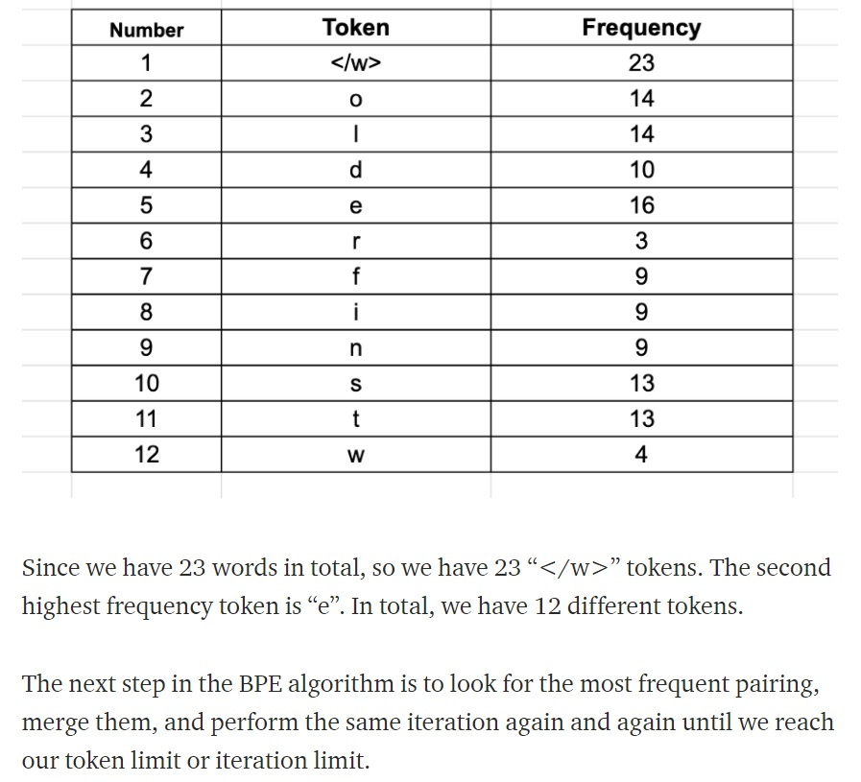

Slide 12
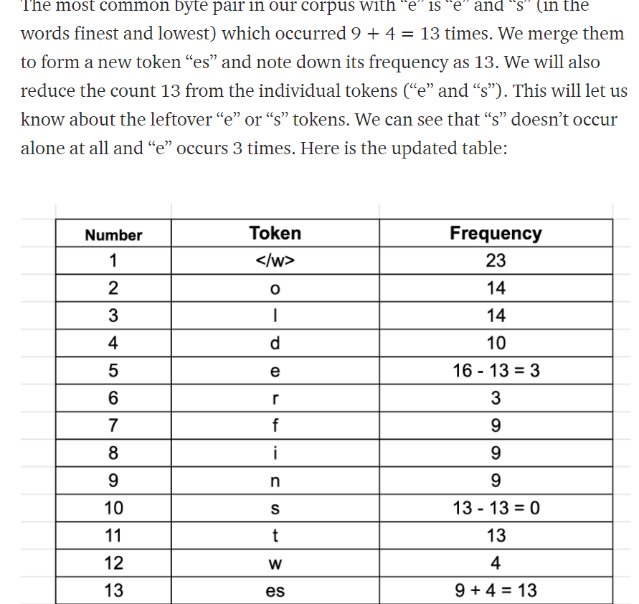

Slide 13
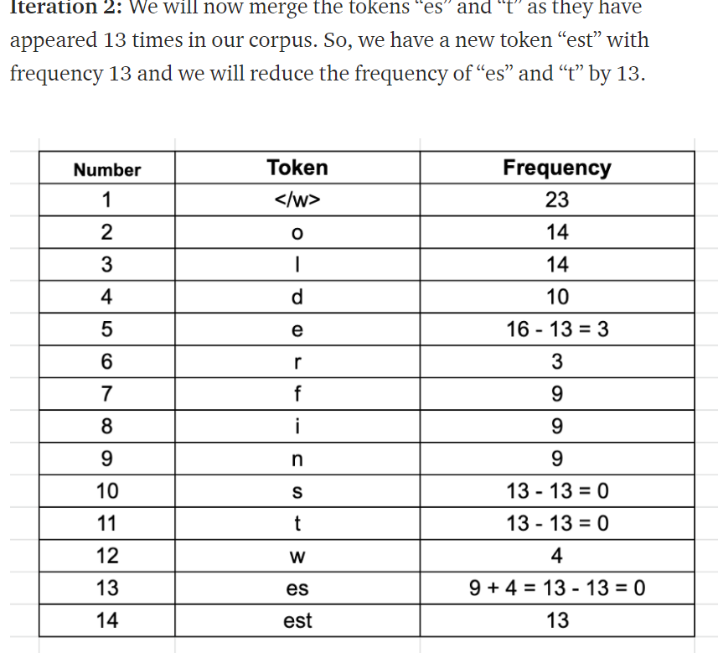
Notes:
Ocr – 광학 문자 인식
Ridge – 융선(지문)

Slide 14
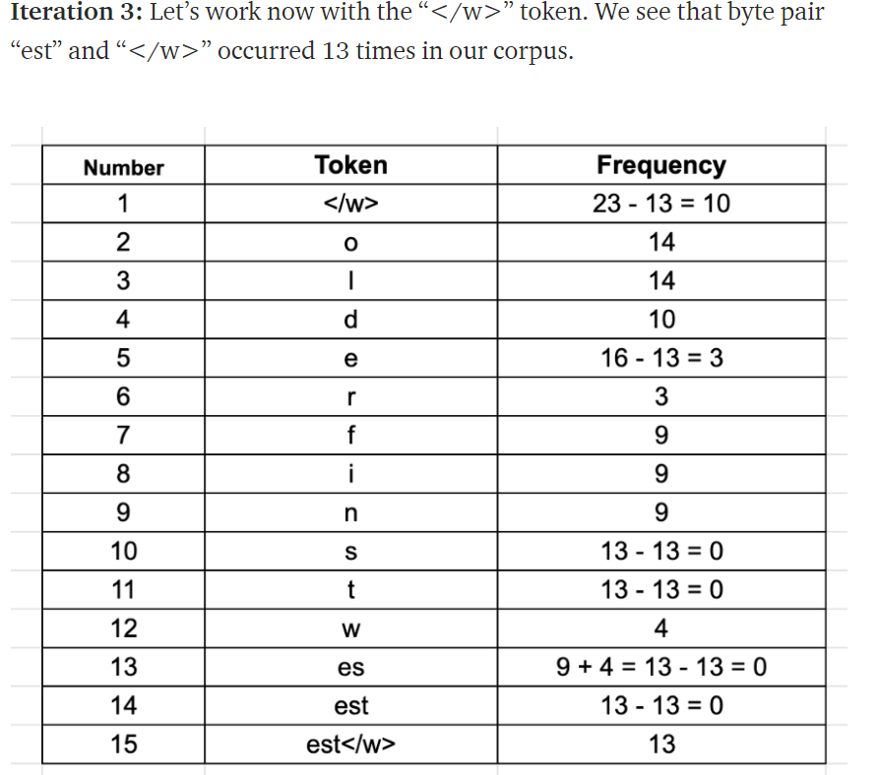

Slide 15
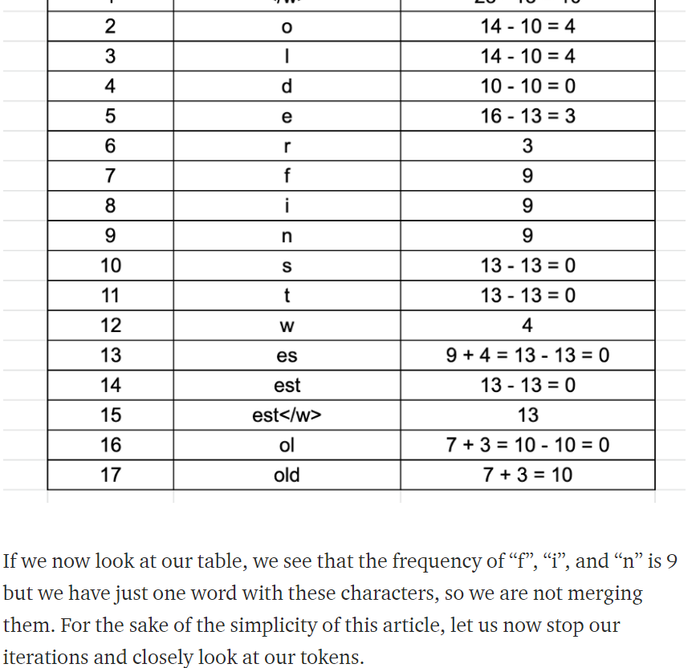
Notes:
Ocr – 광학 문자 인식
Ridge – 융선(지문)

Slide 16
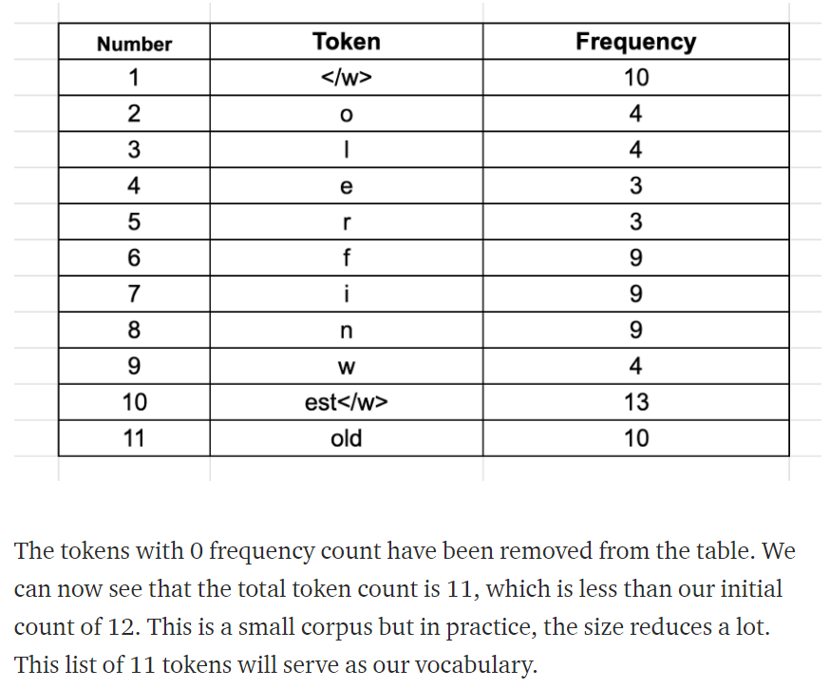

Slide 17
Encoding and Decoding
To decode, we have to simply concatenate all the tokens together to get the whole word. For example, the encoded sequence [“the</w>”, “high”, “est</w>”, “range</w>”, “in</w>”, “Seattle</w>”], we will be decoded as [“the”, “highest”, “range”, “in”, “Seattle”] and not as [“the”, “high”, “estrange”, “in”, “Seattle”]. Notice the presence of the “</w>” token in “est”.
However, encoding in itself is computationally expensive. Suppose the sequence of words is [“the</w>”, “highest</w>”, “range</w>”, “in</w>”, “Seattle</w>”]. We will iterate through all the tokens we found in our corpus — longest to the shortest and try to replace substrings in our given sequence of words using these tokens. In practice, we save the pre-tokenized words in a dictionary.

Slide 18
https://leimao.github.io/blog/Byte-Pair-Encoding/
Pseudocode for more understanding.
https://github.com/huggingface/tokenizers
huggingface tokenizers code

Slide 19
Assignment
Train a Byte-Pair Encoding tokenizer with the text file given below:
https://raw.githubusercontent.com/dscape/spell/master/test/resources/big.txt
You can use huggingface/tokenizer library (import BpeTrainer) for training. Using your trained tokenizer ,perform encoding and decoding given an input sentence.(For ex: “This is a simple tokenizer”).

Slide 20
Thank you!
Notes:
Ocr – 광학 문자 인식
Ridge – 융선(지문)

